Slide 1
Local Law 152 of 2016:
2021
presented by
Shawn Jones
Chief Inspector Plumbing Unit

Slide 2
Agenda
Introduction to the Department
About DOB’s Plumbing Unit
Local Law 152 of 2016 Overview
Compliance
Additional Tips & Information
Resources
Notes:
Greetings, welcome …

Slide 3
WHO WE ARE
Team of professionals dedicated to the safety of all who build, work and live in New York City.
Committed to providing efficient service
Streamlined
Understandable
Transparent
Consistent
Notes:
This slide begins preface material about the NYC Department of Buildings.

Slide 4
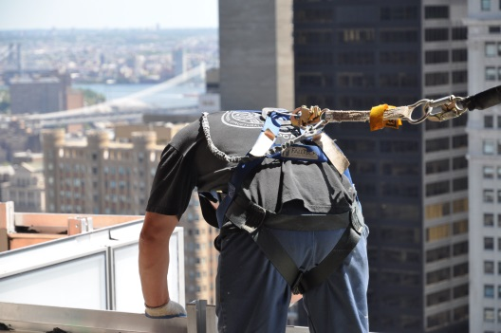
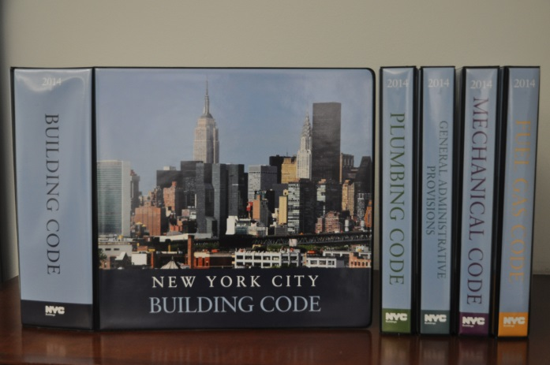
What we do
Ensure the safe and lawful use of over one million buildings and construction sites throughout the City
Facilitate safe and responsible development by enforcing the NYC Building Code and Zoning Resolution
Conduct emergency response and hold construction professionals accountable

Slide 5
THE DEPARTMENT
COMMISSIONER
Melanie LaRocca
Legal &
Regulatory Affairs Office of General Counsel
Enforcement
Administration & Finance
Development & Technical Affairs
Strategic Planning & Policy
External Affairs
Communications
& Marketing
Budget, Fiscal, Procurement, Human Capital, and, Asset Management
Safety, Inspections, and
Enforcement
Code, Zoning, and Research
Department Modernization
Government, Industry, and Public
Communication with all Stakeholders
Legal, Legislative, and Licensing Services
Over 1,500 Employees

Slide 6
Building one city plan
GOALS
100% of applications, reviews, payments, and scheduling can be completed online
Status of all projects is accessible and transparent – with alerts when we take action
Highest risk and highest priority work are targeted first with resources

Slide 7
Building one city plan
GOALS
Promote integrity and adherence to first-ever Industry Code of Conduct
Processing and response times are best-in-class for major U.S. cities
Affordable Housing Unit prioritizing affordable housing filings

Slide 8
BUILDING ONE CITY PLAN
21st CENTURY AGENCY
DOB NOW is an interactive, web-based portal that will enable building owners, design professionals, filing representatives, and licensees to do all business with DOB online.
Greater Transparency
Improved Processing
Better Customer Service
Enhanced Public Safety

Slide 9
Dob by the numbers
ACTIVITY HIGHLIGHTS: FY 2020
Borough Filings
HUB
Filings
DOB NOW
Filing Reviews
Active Permits
New Floor
Area
60,240
18,314
58,309
136,415
40,816,434

Slide 10
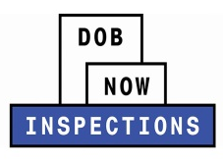
DOB BY THE NUMBERS
DOB NOW FY 2020 YEAR IN REVIEW
FILINGS
NEW MAJOR RELEASES
Limited Alteration Application
Place of Assembly
Temporary Place of Assembly
Mechanical
Structural
Cranes (prototypes devices, notices)
Elevator
Boiler
Facade
87,000+
61,000+
Boiler
Electrical
Mobile Summons
121,000+
17,000+
Elevator
LAA
Journeyman
Welder
Gas Work Qualification
2,800+
58,000+
Façade
Other Work Types
48 External Trainings │ 4,854 Registrants
INSPECTIONS
LOOKING AHEAD TO FY 2021
New Worktypes
Job Type Structure
Occupancy
220,000+
General Construction
Earthwork
Foundation
Protection & Mechanical Methods, Support of Excavation
Building level Schedule of Occupancy
CO issuance
Inspection Requests
New Buildings
Alteration-(CO)
19,000+
Mobile Summons

Slide 11
DOB BY THE NUMBERS
COVID-19 Response
Essential Construction permits
Certificate of Correction Review Requests
Civil Penalty Review Requests
License Renewal Applications
Payments for Boiler & Elevator Violations

Slide 12
DOB BY THE NUMBERS
JOB FILINGS
JOB TYPE | FY 2016 | FY 2017 | FY 2018 | FY 2019 | FY 2020
NB | 3,215 | 2,879 | 2,829 | 2,687 | 1,894
Alt-1 | 4,838 | 4,610 | 4,877 | 4,702 | 3,614
Alt-2 & Alt-3 | 70, 892 | 70, 645 | 61, 856 | 52, 008 | 39,487
DOB NOW: Build | - | 58 | 48, 636 | 115, 604 | 139,320
Notes:
Notes:
Reduction in A2 numbers reflects shift to DOB NOW.
DOB NOW filings also include Electrical filings (added FY 2018), Elevator filings (added FY 2018), Limited Alteration Applications (added FY 2019), Place of Assembly & Temporary Place of Assembly filings (added FY 2019).

Slide 13
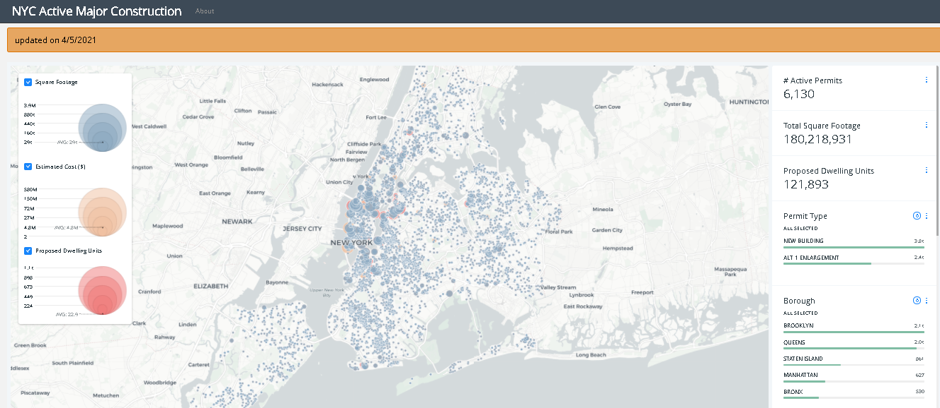
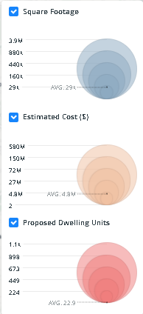
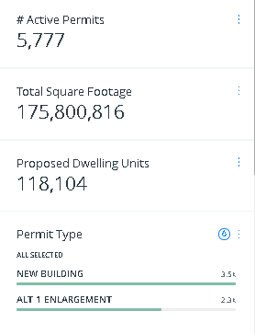
DOB BY THE NUMBERS

Slide 14
Local law 152 of 2016
What You Need to Know

Slide 15
Local law 152 of 2016
Became law in 2016 and inspection time period began January 1, 2020
Original deadline to complete initial round of inspections for Community Districts 1, 3, and 10 - December 31, 2020, but was extended to June 30, 2021
Original deadline to complete initial round of inspections for Community Districts 2, 5, 7, 13, and 18 - December 31, 2021, but was extended to June 30, 2022
Mandates gas piping systems in all buildings, except for buildings classified in occupancy group R-3, be inspected by a Licensed Master Plumber
Goal is to prevent gas leaks and potential dangerous outcomes

Slide 16
Building Occupancy Type Exceptions
Buildings classified as part of the R-3 Occupancy Group are exempt from LL152 of 2016 inspections
This classification includes most one or two-family homes, convents and monasteries with fewer than 20 occupants, group home community facilities in one or two-family buildings

Slide 17
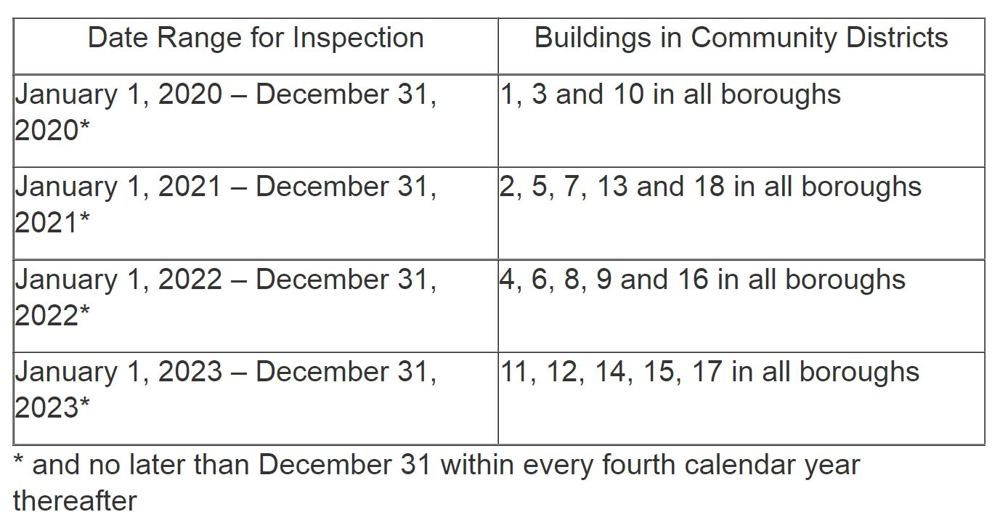
Inspection Schedule
Gas piping systems must be inspected at least once every four years according to the schedule below.

Slide 18
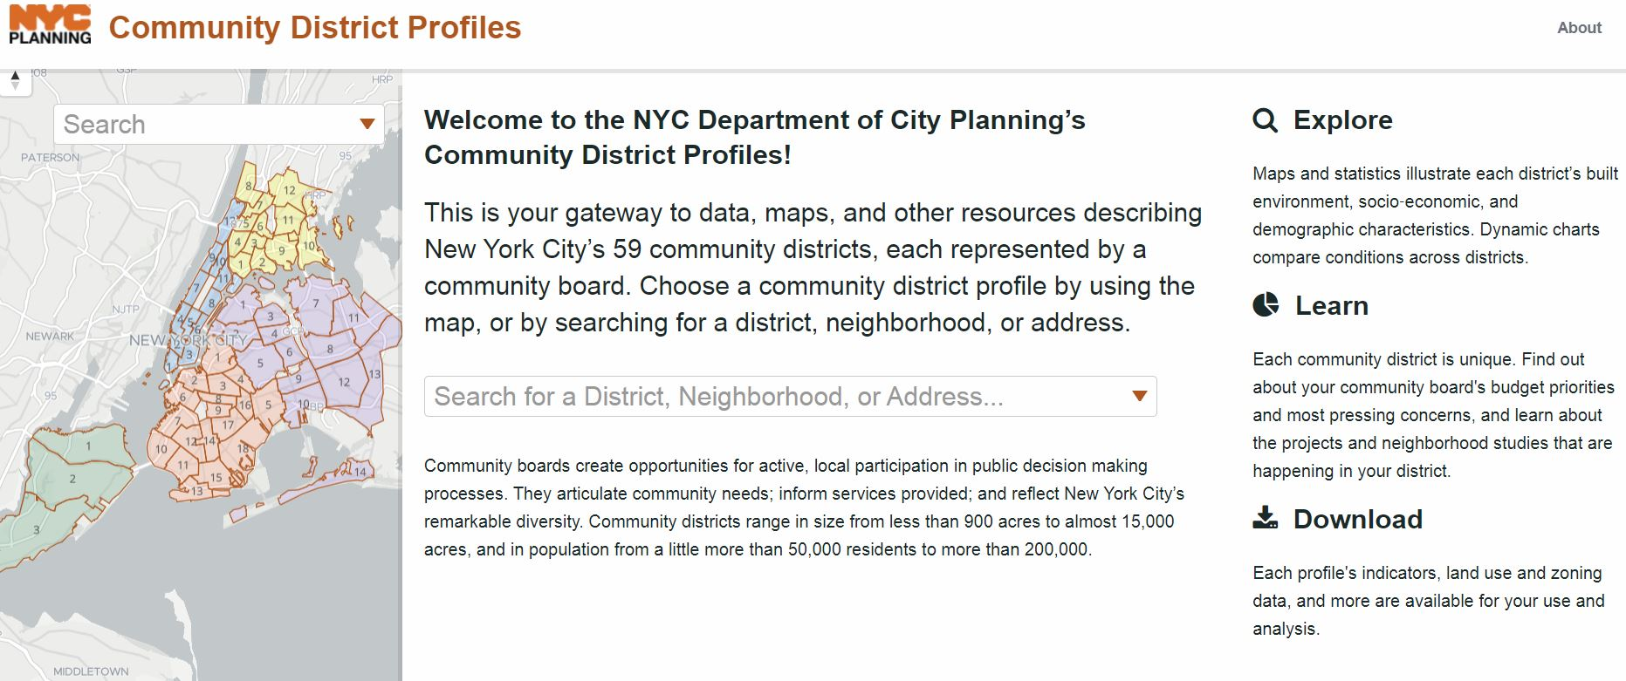
NYC Community District search
Know when your building must be inspected by checking its community district.

Slide 19
Exposed Gas Piping
Exposed gas piping includes gas piping that is open to view.
It does not include gas piping above a drop ceiling or behind an access door.
If your building does not contain gas piping, a Gas Piping System Periodic Inspection Certification, signed and sealed by a Registered Design Professional, stating that such building contains no gas piping must be submitted to DOB.

Slide 20
Inspections Overview
All exposed gas piping from point of entry of gas piping into the building, including building services meters, and all gas piping in public spaces, hallways, corridors and mechanical and boiler rooms inside and outside a building, including rooftops must be inspected.
Includes all rooms (up to a tenant space) containing a gas appliance.
This does not include gas piping within tenant spaces.
Equipment such as pressure regulator, regulator vents, valves, sleeves, POE seals, etc., should be inspected.

Slide 21
Inspections overview cont’d
What is NOT Inspected during a LL152 of 2016 Inspection
Tenant spaces (no exceptions)
Buried gas piping
Properties that presently do not have gas service or appliances connected to any gas piping (provide a signed statement from utility company to verify)
Notes:
Speaker will address the most common complaints received by tenant

Slide 22
How to Complete the Inspection
Hire a Licensed Master Plumber to Inspect the Building’s Gas Piping System
Make sure their license is active by using the License Search tool. You may search a licensee by name, business name, or license number.
Review the disciplinary actions taken against a licensee by DOB or voluntary surrender records by using the Know Your Construction Professional tool.
Notes:
Catchall legal rights for tenant

Slide 23
How to complete the inspection
The inspector must be provided full access to all non-tenant areas in order for the inspection to be certified as complete.
If they are not able to gain access, the inspection must be repeated.
Once the inspection is completed, your Licensed Master Plumber must submit a Gas Piping System Periodic Inspection Report (GPS1) to the owner or owners representative within 30 days of inspection.
Within 60 days of the inspection, you must submit a Gas Piping System Periodic Inspection Certification (GPS2) signed and sealed by the Licensed Master Plumber who conducted or supervised the inspection to DOB.
The Gas Piping System Periodic Inspection Certification (GPS2) must be uploaded to the GPS2 Certification Submission Portal

Slide 24
Correcting Conditions
Unsafe and hazardous conditions such as a gas leak, illegal connection or non-code compliant installation require immediate notification.
If conditions requiring correction were identified you must submit a Gas Piping System Periodic Inspection Certification (GPS2 form) signed and sealed by the Licensed Master Plumber who conducted the inspection, stating that the conditions have been corrected within 120 days of the inspection.
If the Gas Piping System Inspection Certification submitted to DOB indicated that additional time was needed to correct the condition(s) identified during the gas piping system inspection, you must submit to DOB, within 180 days of the inspection, a Gas Piping System Periodic Inspection Certification (GPS2 Form).
Correction of conditions identified during a gas piping system inspection must be performed in compliance with the New York City Construction Codes, including obtaining any required work permits.
Notes:
So what is a Tenant Protection Plan?
This slide should also help segue to the next section about the use of a TPP.

Slide 25
Additional Tips & Information
To access the portal, use Google Chrome & clear cache
When uploading the GPS2 form to the portal, the GPS2 form must be a pdf
Refrain from uploading an image of the GPS2 form; images are too large and the portal will give an error message
Reach out to DOB to troubleshoot further technical issues when uploading GPS2 form to the portal
DOB receives weekly generated reports of uploaded GPS2 forms; we can check by address and only view submission date
Inspections conducted by utility companies do not meet Local Law 152 requirements. If the property needs to comply with Local Law 152 and was previously inspected by a utility company, the owner must hire a Licensed Master Plumber to conduct the inspection to follow Local Law 152.
Properties with certificate of occupancies dated after December 6, 2016, will be exempt for ten years. Once ten years expire, an inspection is required every 4 years thereafter
Inspection deadline extension: Additional 180 days extension is granted if owner is unable to obtain inspection; must submit GPS2 form

Slide 26
Resources
Local Law 152 of 2016 Service Notice:
LL 152 RULE.pdf
DOB Local Law 152 of 2016 FAQs: https://www1.nyc.gov/assets/buildings/pdf/ll152of2016_faq.pdf
Submit questions to DOB Plumbing Enforcement – 212-393-2557/ LL152of16@buildings.nyc.gov
Department of Buildings Website:
https://www1.nyc.gov/site/buildings/index.page
Report exposed gas piping to:
Con Edison – 800-752-6633
National Grid – 718-643-4050

Slide 27
Thank you

